Slide 1


MSA and Structural homology
Paweł Dąbrowski-Tumański
MiNI Lecture, Fall 2025

Slide 2






Sequence vs structure
Sześcian
🧬 Homology reveals evolutionary and functional relationships
Sześcian
🏗️ Structure is often more conserved than sequence
Sześcian
🔍 Understanding structure enables annotation, modeling, and drug design
Sześcian

Slide 3
CASP
Sześcian
🏆 CASP (Critical Assessment of Structure Prediction) — biennial blind test since 1994
Sześcian
📈 Benchmarking structure prediction accuracy (GDT-TS, TM-score)
Sześcian
Sześcian
🚀 CASP14 (2020): AlphaFold2 achieved near-experimental accuracy

Slide 4
From pairwise to mutliple sequences
Sześcian
🔄 Pairwise alignment → compare two sequences (Needleman–Wunsch, Smith–Waterman)
Sześcian
📊 MSA aligns many homologous sequences simultaneously
Sześcian
💡 Reveals conserved motifs and evolutionary constraints
Sześcian

Slide 5

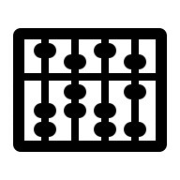
MSA - concepts
Sześcian
🧩 Align residues across all sequences → columns = homologous positions
Sześcian
🧬 Highlights conserved residues → structural/functional importance
Sześcian
Sześcian
📈 Applications: phylogenetics, motif discovery, coevolution analysis

Slide 6
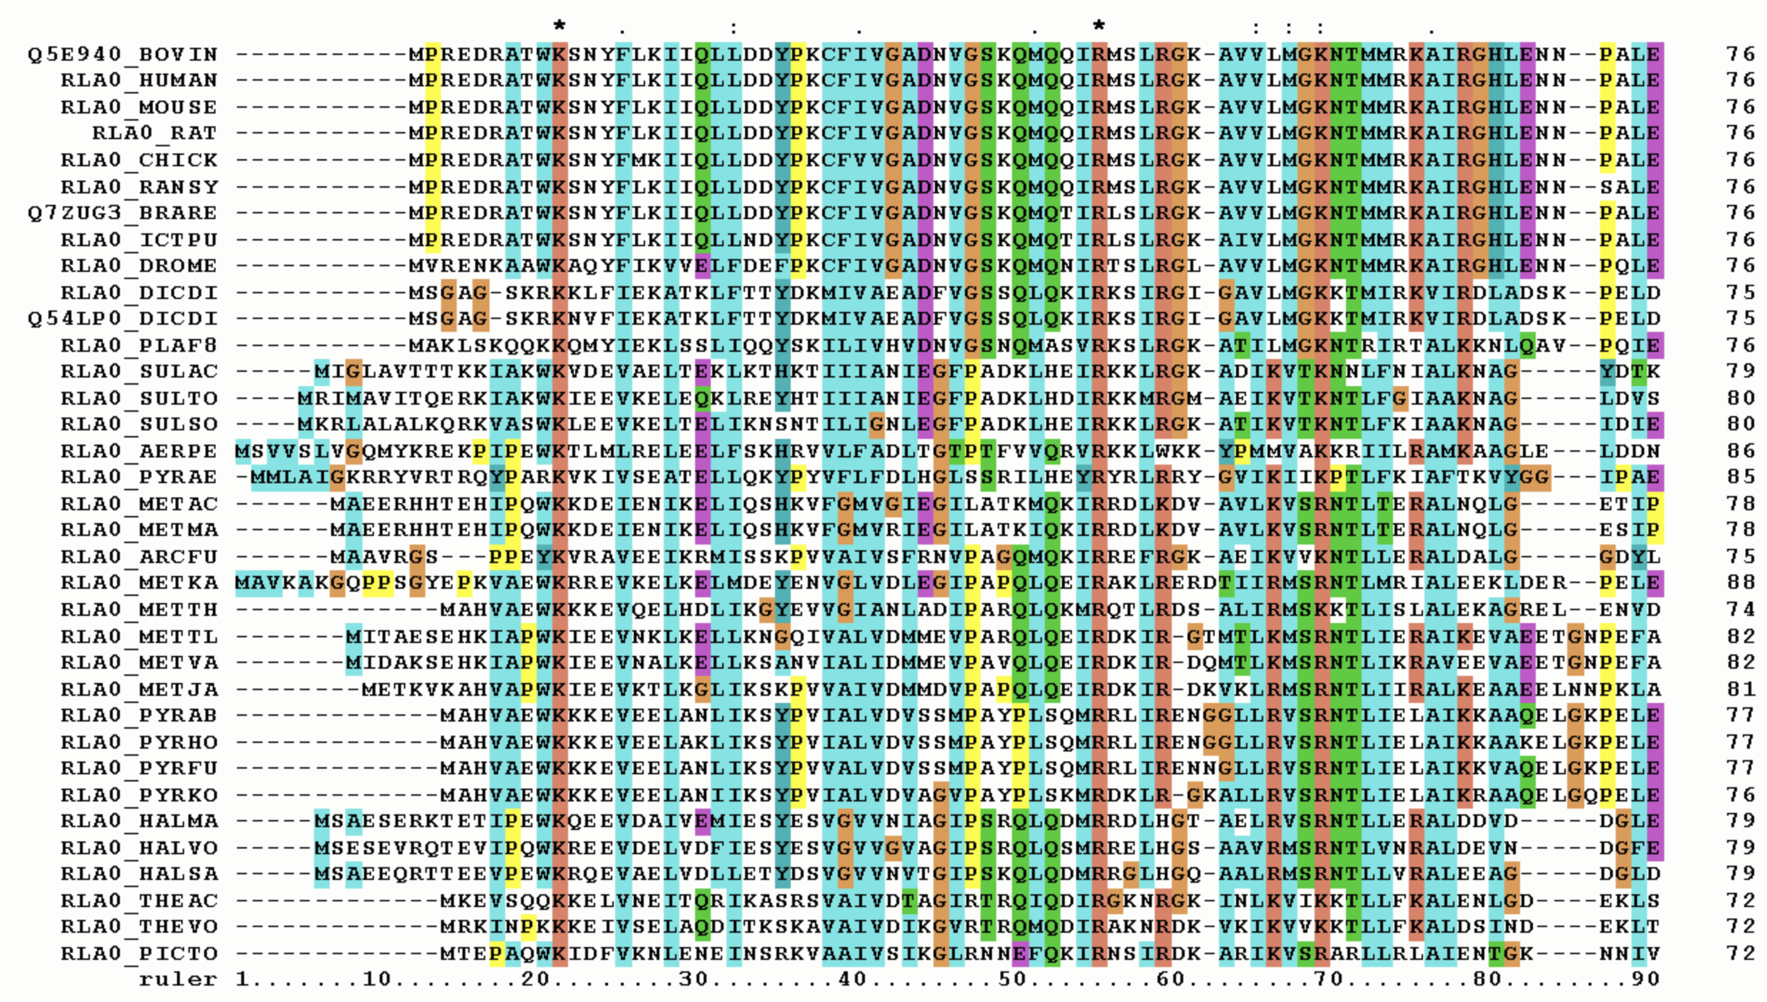
MSA - example
Sześcian
Sześcian
Sześcian
Sześcian

Slide 7
Clustal
Sześcian
🪜 Builds alignment progressively using guide tree
Sześcian
⚖️ Simple and fast, but early errors propagate
Sześcian
💾 Produces standard Clustal format outputs
Sześcian

Slide 8
Clustal
Sześcian
🧩 Pairwise Alignment – Compute all pairwise sequence alignments
Sześcian
📊 Distance Matrix Creation – Convert pairwise alignment scores into a distance matrix
🌳 Guide Tree Construction – Build a guide tree (usually using Neighbor-Joining or UPGMA)
Sześcian
🔗 Progressive Alignment – Align sequences progressively following the branching order of the guide tree
Sześcian
🧵 Profile Alignment –align groups of sequences instead of individual sequences

Slide 9
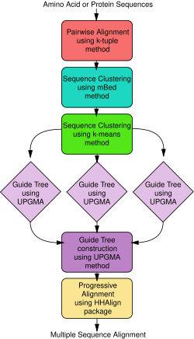
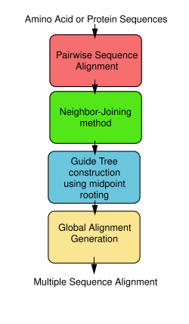
ClustalW vs ClustalO
Sześcian
Sześcian
Sześcian
Sześcian

Slide 10
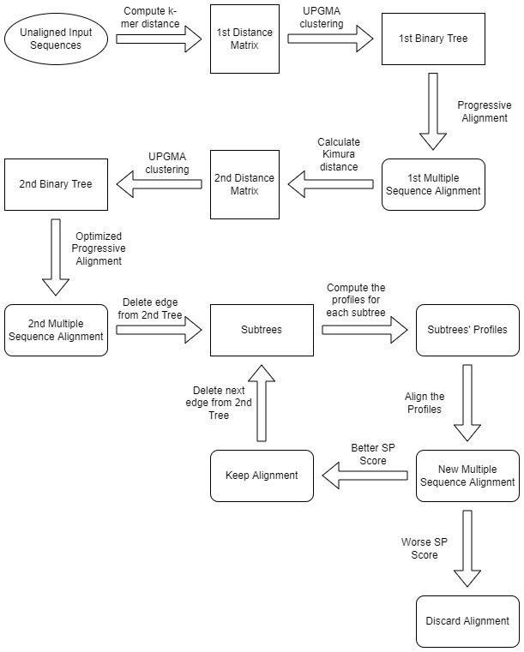
Iterative algorithms - MUSCLE
Sześcian
🔁 Refines alignment through multiple iterations
Sześcian
⚡ Faster and more accurate than early tools
Sześcian
Sześcian
🧠 Combines global and local refinement strategies

Slide 11
Consistency-based T-Coffee
Sześcian
☕ Combines results from multiple pairwise alignments
Sześcian
🎯 Improves consistency between sequences
Sześcian
Sześcian
📈 Often used for high-accuracy small MSAs

Slide 12
Classical algorithms - comparison
Sześcian
Feature | Clustal 🧩 | MUSCLE 🔄 | T-Coffee 📚
Approach | 🔗 Progressive alignment | 🔗 + 🔄 Iterative refinement | 🔗 + 📚 Consistency-based scoring
Distance Estimation | 📊 Pairwise alignment scores | 🔍 k-mer based approximate distances | 🧩 Pairwise alignments → library of constraints
Guide Tree | 🌳 Built from distance matrix | 🌳 Iteratively refined tree | 🌳 Built using consistency from library
Refinement | ❌ None | 🔧 Iterative tree realignment | ✅ Consistency-based alignment refinement
Speed | ⚡ Fast | ⚡ Fast, scalable | 🐢 Slower due to library/scoring
Accuracy | 👍 Moderate | 💪 High | ⭐ Very high, especially for divergent sequences
Best Use Case | 🏃 Quick alignment of close sequences | 🏋️ Large datasets, balanced speed & accuracy | 🎯 High accuracy needed, divergent sequences
Scoring | 📏 Pairwise | 🧵 Profile-based scoring | 🧩 Consistency-based
Sześcian
Sześcian
Sześcian

Slide 13
Classical algorithms - comparison
Sześcian
🧩 Clustal → simple, fast, older method, best for close sequences
Sześcian
🔄 MUSCLE → fast, iterative, good balance of speed and accuracy
Sześcian
Sześcian
📚 T-Coffee → slower but very accurate, especially for divergent sequences, using consistency-based scoring

Slide 14
Formats - FASTA
Sześcian
📄 Simple text format: header (>) + sequence lines
Sześcian
>Seq1
ATGCTG
>Seq2
ATG-TG
>Seq3
ATGCCG
🧬 Common for raw and aligned sequences
Sześcian
Sześcian
🔍 Compatible with most alignment and database tools

Slide 15
Formats - Clustal
Sześcian
📄 Block-aligned format with alignment markers (*, :, .)
Sześcian
Seq1 ATGCTG
Seq2 ATG-TG
Seq3 ATGCCG
*** **
👀 Human-readable → easy to visualize conservation
Sześcian
Sześcian
📘 Used by ClustalW and MUSCLE outputs

Slide 16
Formats - Stockholm
Sześcian
📘 Rich annotation format used in Pfam and Infernal
# STOCKHOLM 1.0
#=GF ID Example_MSA
#=GF DE Example of annotated MSA
#=GS Seq1 AC Seq1_annotation
#=GS Seq2 AC Seq2_annotation
#=GS Seq3 AC Seq3_annotation
#=GC RF ***..*
Seq1 ATGCTG
Seq2 ATG-TG
Seq3 ATGCCG
//
Sześcian
🧠 Stores metadata (accession, description, secondary structure)
Sześcian
Sześcian
🔢 Supports consensus sequences and scoring

Slide 17
Databases – Uniprot & UniRef
Sześcian
🧬 UniProt: curated protein sequences and metadata
Sześcian
🧱 UniRef: clustered versions (UniRef100, 90, 50) for redundancy reduction
Sześcian
Sześcian
🔗 Primary source for alignment and model training

Slide 18
Big Fantastic Database
Sześcian
🌌 Massive sequence database (>2 billion sequences)
Sześcian
⚙️ Used for DL pretraining (ESM, AlphaFold2, RoseTTAFold)
Sześcian
Sześcian
📦 Includes metagenomic and environmental sequences

Slide 19
MGnify
Sześcian
🌿 Metagenomic protein sequences from environmental samples
Sześcian
🧫 Expands sequence diversity and evolutionary depth
Sześcian
Sześcian
🔍 Used to improve MSA quality for rare proteins

Slide 20
PFAM
Sześcian
🏷️ Protein family database → domain-level alignments and HMMs
Sześcian
📘 Each Pfam entry includes a seed alignment in Stockholm format
Sześcian
Sześcian
🔗 Enables annotation of conserved domains

Slide 21
Databases - comparison
Sześcian
Feature | UniProt 🧬 | BFD 🌌 | MGnify 🏞️ | PFAM 🔖
Type | Curated protein sequences | Ultra-large protein sequence clusters | Metagenomic protein sequences | Protein family HMMs / domains
Source | Known organisms (Swiss-Prot + TrEMBL) | UniProt + environmental / metagenomic sequences | Environmental & microbiome samples | Curated protein domains from UniProt & other databases
Sześcian
Sześcian
Sześcian

Slide 22
Databases - comparison
Sześcian
Feature | UniProt 🧬 | BFD 🌌 | MGnify 🏞️ | PFAM 🔖
Sequence curation | High (Swiss-Prot) / moderate (TrEMBL) | Low–moderate | Low, predicted from metagenomes | High, manually curated families
Scope / Size | ~230M sequences (TrEMBL) | ~2.5B sequences, clustered to ~65M clusters | Millions of sequences from metagenomes | ~20K families (PFAM 35)
Sześcian
Sześcian
Sześcian

Slide 23
Databases - comparison
Sześcian
Feature | UniProt 🧬 | BFD 🌌 | MGnify 🏞️ | PFAM 🔖
Clustering / Redundancy reduction | UniRef100/90/50 | MMseqs2 / Linclust clustering | Clustering at various identity thresholds | HMMs represent families; sequences assigned to families
Annotations | Functional, structural, taxonomic | Minimal, mainly for homology | Predicted function/taxonomy | Functional domains, conserved motifs
Sześcian
Sześcian
Sześcian

Slide 24
Databases - comparison
Sześcian
Feature | UniProt 🧬 | BFD 🌌 | MGnify 🏞️ | PFAM 🔖
Purpose / Use-case | Reference sequences, functional annotation | MSA & homology search for large datasets (e.g., AlphaFold2) | Explore microbial diversity, novel genes | Domain identification, functional motifs, sequence annotation
Speed / Accessibility | Fast, standard tools | Very large, needs high-performance tools | Moderate, depending on dataset | Fast, HMM-based search tools (hmmscan)
Sześcian
Sześcian
Sześcian

Slide 25
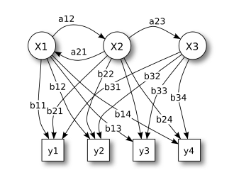
Hidden Markov Model
Sześcian
Sześcian
Sześcian
Sześcian
📘 Knowing income (X1, X2, X3) and sequence of outcomes (y1, y2, y2, y1, y3, y4, …) guess weights.

Slide 26
HMM in Bioinformatics
Sześcian
🧱 States represent alignment positions Each column in a multiple sequence alignment (MSA) corresponds to a match, insert, or delete state.
Sześcian
Sześcian
🎯 Captures conservation and variability Highly conserved residues → high match probability Variable regions → higher insert/delete probabilities
Sześcian

Slide 27
JackHMMer
Sześcian
🏁 Start with a single query sequence
Sześcian
🗂️ Find similar sequences in a database
🧮 Build a Multiple Sequence Alignment (MSA)
Sześcian
🧠 Construct a Profile-HMM from the MSA
🔁 Search again using the Profile-HMM
Sześcian
🧹 Filter sequences based on significance cutoff
♻️ Repeat several iterations

Slide 28

MMSeq2 – fast homology search
Sześcian
⚡ Many-against-many sequence search engine
Sześcian
🧩 Used in ColabFold / AlphaFold pipelines to generate MSAs
Sześcian
Sześcian
🚀 100× faster than BLAST / JackHMMER using k-mer prefiltering

Slide 29
MSA usecases
Sześcian
Application | Role of MSA | Example Tool / Database
🌳 Phylogenetics | Identify conserved/variable sites | RAxML, PhyML
🧬 Structure Prediction | Input for contact prediction & deep learning models | AlphaFold, RoseTTAFold
⚡ Functional Annotation | Detect conserved functional residues | Pfam, InterPro
🧪 Mutational Analysis | Conservation → mutation impact | EVmutation, DeepSequence
🔍 Motif Discovery | Consensus sequences, conserved motifs | MEME, WebLogo
🛠️ Protein / Peptide Design | Identify mutationally tolerant sites | Protein engineering, vaccine design
🔗 Homology Search | Build profiles/HMMs for sensitive search | PSI-BLAST, HMMER
Sześcian
Sześcian
Sześcian

Slide 30

From sequence to structure
Sześcian
🔗 Sequence similarity ≠ structural similarity
Sześcian
🏗️ Structure is more conserved → better reflects evolutionary ancestry
Sześcian
Sześcian
🧠 Structural comparison complements sequence alignment

Slide 31
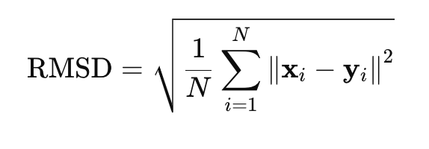
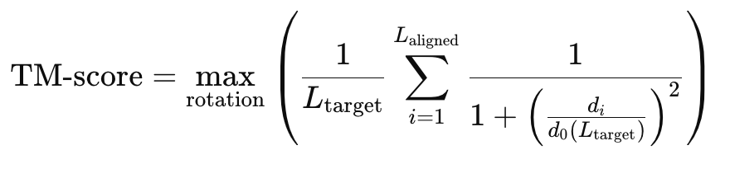
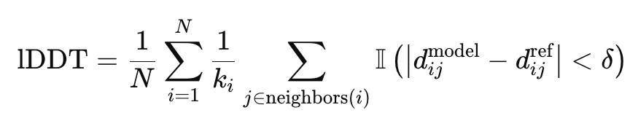
Metrics
Sześcian
🧮 TM-score and RMSD – global structural accuracy
Sześcian
Sześcian
🧬 lDDT – local distance-based accuracy
Sześcian

Slide 32
Metrics
Sześcian
Metric | Alignment Required? | Sensitive to Outliers? | Measures
RMSD | ✅ yes | High sensitivity | Global deviation
TM-score | ✅ yes | Lower sensitivity | Overall fold similarity
lDDT | ❌ no | Low sensitivity | Local geometric correctness
Sześcian
Sześcian
Sześcian

Slide 33
DALI
Sześcian
🧱 Represent structures as distance matrices
🔍 Search for local structural patterns
Sześcian
🧩 Align fragments to build initial alignment
Sześcian
🔄 Iterative refinement
Sześcian
📉 Minimize distance error
🏆 Calculate Z-score to assess significance

Slide 34
Protein Data Bank
Sześcian
📦 Repository of experimentally determined 3D structures
Sześcian
🧪 Sources: X-ray crystallography, NMR, Cryo-EM
Sześcian
Sześcian
🌐 Access via RCSB interface and Mol* visualization

Slide 35
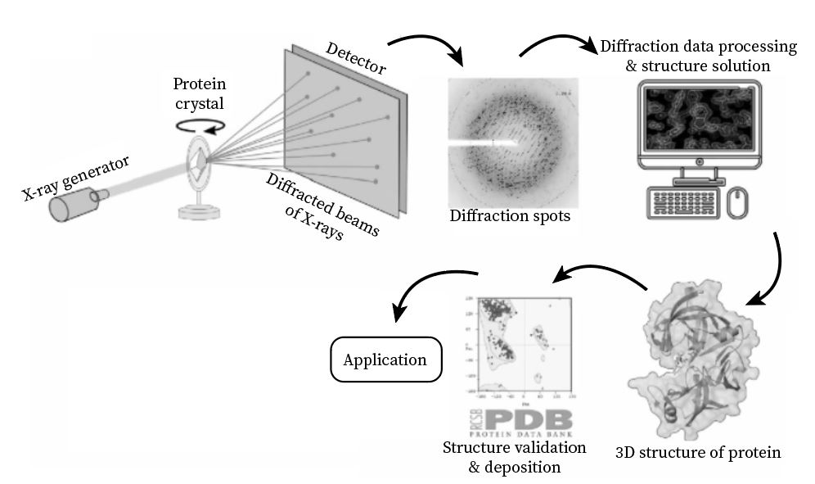
X-Ray crystallography
Sześcian
Sześcian
Sześcian
Sześcian

Slide 36
Protein structure prediction methods
Sześcian
Feature | X-ray Crystallography 💎 | NMR Spectroscopy 🧪 | Cryo-Electron Microscopy ❄️
Principle | Diffraction of X-rays through protein crystals | Magnetic resonance of atomic nuclei in solution | Imaging of flash-frozen proteins by electron beams
Sample state | Crystalline solid | Solution (liquid) | Frozen hydrated sample (near-native)
Size range | Small to very large (no strict limit, but easier for <200 kDa) | Small to medium (~5–50 kDa ideal) | Small to very large complexes (>150 kDa, even megadalton assemblies)
Resolution | High (1–3 Å typical) | Moderate (~2–3 Å for small proteins, lower for large) | Moderate to high (2–4 Å typical with latest instruments)
Sześcian
Sześcian
Sześcian

Slide 37
Protein structure prediction methods
Sześcian
Feature | X-ray Crystallography 💎 | NMR Spectroscopy 🧪 | Cryo-Electron Microscopy ❄️
Strengths | Very high atomic detail; mature technique | Can study proteins in solution; dynamics & flexibility | Can capture large complexes, membrane proteins, flexible regions
Limitations | Requires crystallization; may not capture dynamic states | Size limitation; low sensitivity for large proteins | Resolution historically lower; requires expensive equipment & large datasets
Time / effort | Weeks to months (crystal growth, diffraction) | Weeks (sample prep, spectra acquisition) | Weeks to months (sample prep, data collection, computation)
Best for | High-resolution atomic models | Small proteins, flexible proteins, dynamics studies | Large complexes, membrane proteins, native-like assemblies
Sześcian
Sześcian
Sześcian

Slide 38
Possible problems
Sześcian
🧩 Missing residues / incomplete chains
Sześcian
❌ Missing atoms / side chains
🔄 Alternative conformations
Sześcian
⚡ High B-factors / disorder
Sześcian
🧱 Non-standard residues / ligands

Slide 39
PDB vs MMcif
Sześcian
ATOM 1 N MET A 1 -12.048 -14.461 14.670 1.00 17.87 N
ATOM 2 CA MET A 1 -12.551 -15.775 15.157 1.00 21.28 C
ATOM 3 C MET A 1 -11.470 -16.860 15.096 1.00 20.50 C
ATOM 4 O MET A 1 -11.558 -17.892 15.779 1.00 18.56 O
ATOM 5 CB MET A 1 -13.739 -16.242 14.296 1.00 27.25 C
ATOM 6 CG MET A 1 -15.070 -15.562 14.565 1.00 21.15 C
ATOM 7 SD MET A 1 -16.236 -16.292 13.466 1.00 26.22 S
ATOM 8 CE MET A 1 -16.712 -17.788 14.407 1.00 21.42 C
Sześcian
Sześcian
loop_
_atom_site.group_PDB
_atom_site.id
_atom_site.type_symbol
_atom_site.label_atom_id
_atom_site.label_alt_id
ATOM 1 N N . MET A 1 1 ? -12.048 -14.461 14.670 1.00 17.87 ? ATOM 2 C CA . MET A 1 1 ? -12.551 -15.775 15.157 1.00 21.28 ? ATOM 3 C C . MET A 1 1 ? -11.470 -16.860 15.096 1.00 20.50 ? ATOM 4 O O . MET A 1 1 ? -11.558 -17.892 15.779 1.00 18.56 ?
Sześcian

Slide 40
3D structures as files
Sześcian
Feature | PDB Format 📄 | mmCIF Format 🧱
Full Name | Protein Data Bank format | Macromolecular Crystallographic Information File
File Type | Legacy, fixed-column text | Modern, flexible text-based table format
Structure Representation | Human-readable but limited field width | Machine-readable and scalable
Line / Column Limits | Strict 80-character line width and fixed columns → can truncate atom names, chain IDs, coordinates | No fixed line widths → supports long names and large coordinate precision
Maximum Number of Atoms / Chains | Limited — large complexes can exceed format capacity | No practical size limit → supports huge complexes (e.g., ribosomes, virus capsids)
Sześcian
Sześcian
Sześcian

Slide 41
3D structures as files
Sześcian
Feature | PDB Format 📄 | mmCIF Format 🧱
Metadata / Annotations | Restricted metadata fields | Extensive metadata support (biological assemblies, experiment details, refinement info, etc.)
Compatibility with Software | Supported by almost all older tools | Preferred / default for new structural biology software
Status in PDB | Still available but phasing out for large structures | Official modern standard — required for deposition
Best Use Case | Quick inspection / small structures | Large structures, computational workflows, archival and automated processing
Sześcian
Sześcian
Sześcian
❗ Use mmCIF

Slide 42
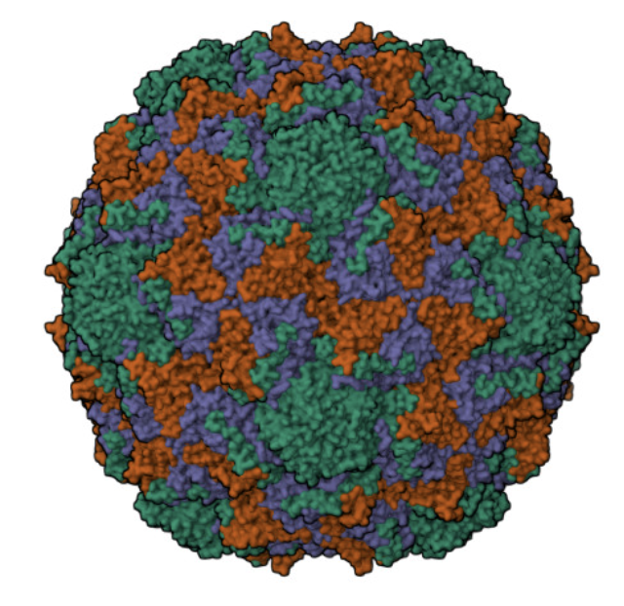
Visualization
Sześcian
🧪 Visualization tools for molecular structures
Sześcian
🎨 Highlight secondary structures, domains, and pLDDT scores
Sześcian
Sześcian
🔍 Support alignment, RMSD, and publication-ready rendering

Slide 43
Visualization tools
Sześcian
Feature | Chimera 🧭 | PyMOL 🔬 | py3Dmol 🌐
User Interface | GUI + command line | GUI + powerful scripting | Usually embedded in Jupyter / web apps (no standalone GUI)
Platform | Desktop application (Win/Mac/Linux) | Desktop application (Win/Mac/Linux) | Runs in browser / notebooks (WebGL)
Strengths | Advanced analysis, electrostatics, domain motions, morphing | High-quality publication-ready images, strong scripting | Easy sharing & embedding, interactive online visualization
Ease of Use | Moderate (many menus/options) | Moderate (GUI good, scripting requires learning) | Easy — especially in Jupyter notebooks or HTML pages
Image Quality | Very good | Excellent (cinematic / ray-tracing options) | Good, but not as photorealistic as PyMOL
Sześcian
Sześcian
Sześcian

Slide 44
Visualization tools
Sześcian
Feature | Chimera 🧭 | PyMOL 🔬 | py3Dmol 🌐
Best For | Structural analysis, research workflows | Figures, animations, precise structure manipulation | Teaching, dashboards, web tools, demos
File Formats Supported | PDB, mmCIF, density maps, trajectories | PDB, mmCIF, many formats if plugins used | PDB, mmCIF (mainly 3D structure only)
Big Structures (ribosomes, EM maps) | ✅ Handles large datasets well | ✅ Can handle large structures but slower on huge EM maps | ⚠️ Limited by browser memory
License | Free for academic use | Commercial license (open source version exists but lagged) | Open-source, free
Typical Users | Structural biologists, computational biochemists | Researchers needing publication-quality visuals | Educators, web developers, fast sharing environments
Sześcian
Sześcian
Sześcian

Slide 45
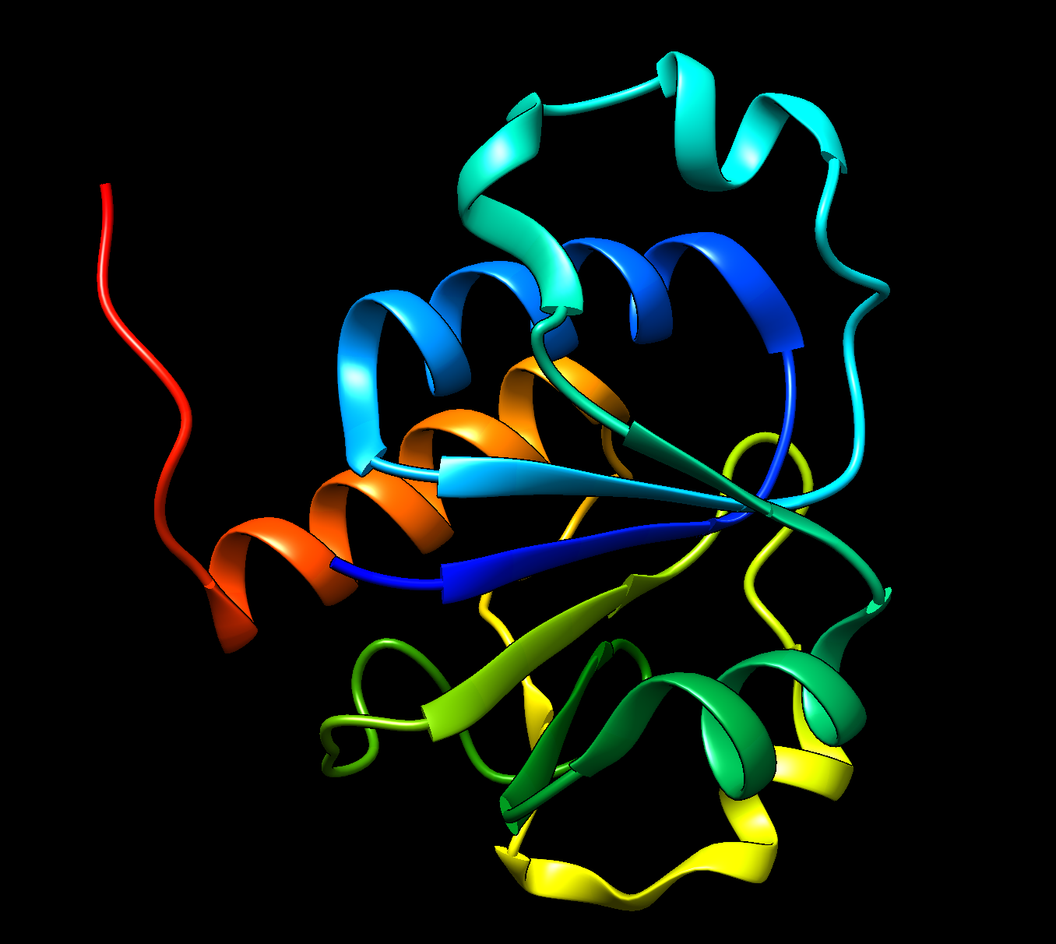
Example
Sześcian
Sześcian
Sześcian
Sześcian

Slide 46

Deep learning revolution
Sześcian
🚀 2018–2020: attention-based models transform structural biology
Sześcian
🧬 Models integrate sequence, MSA, and 3D coordinates
Sześcian
Sześcian
🤝 Combines AI with physical constraints

Slide 47
AlphaFold – New hope from DeepMind
Sześcian
🏆 CASP14 winner – near-experimental accuracy
Sześcian
🔁 Evoformer block for MSA & pair representation updates
Sześcian
Sześcian
📊 Outputs 3D coordinates, pLDDT, and distograms

Slide 48
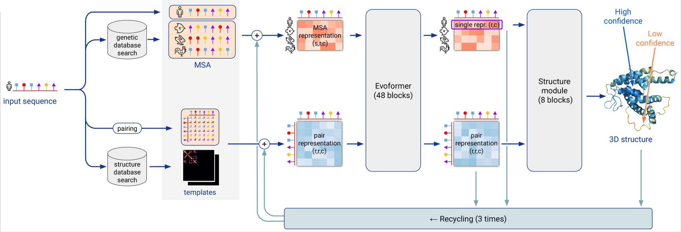
AlphaFold – New hope from DeepMind
Sześcian
Sześcian
Sześcian
Sześcian

Slide 49
ESM – Facebook strikes back
Sześcian
⚡ Single-sequence structure prediction using transformer embeddings
Sześcian
🧠 Built on ESM2 (trained on UniRef50)
Sześcian
Sześcian
🧬 Fast and accurate for well-behaved proteins

Slide 50
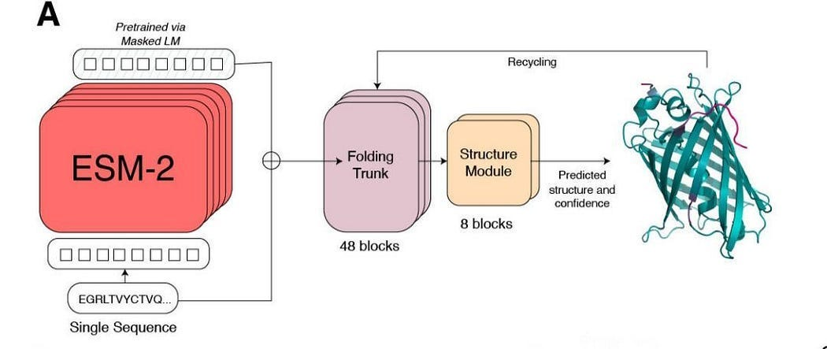
ESM – Facebook strikes back
Sześcian
Sześcian
Sześcian
Sześcian

Slide 51
RoseTTaFold – Return of Experts
Sześcian
🎯 3-track transformer (sequence–MSA–structure integration)
Sześcian
⚙️ Collaborative model from Baker Lab
Sześcian
Sześcian
🧩 Supports structure prediction and modeling complexes

Slide 52
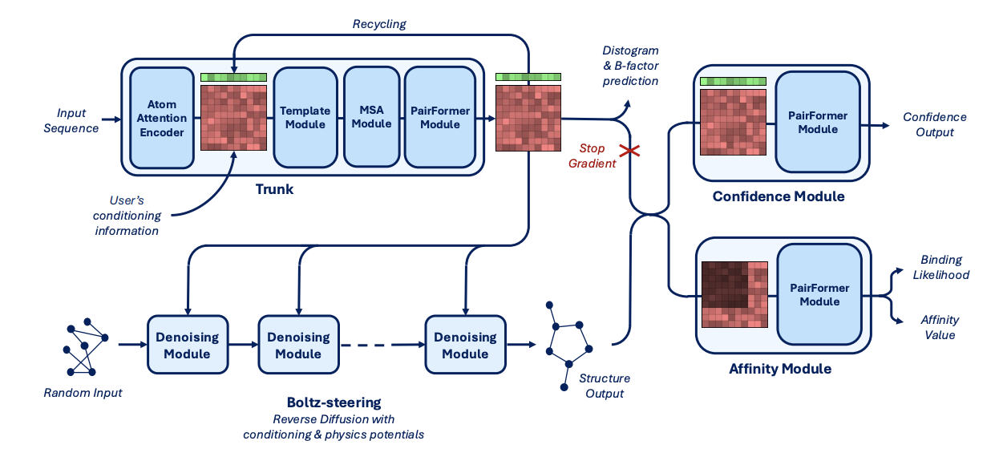
Boltz – Free alternative
Sześcian
Sześcian
Sześcian
Sześcian

Slide 53
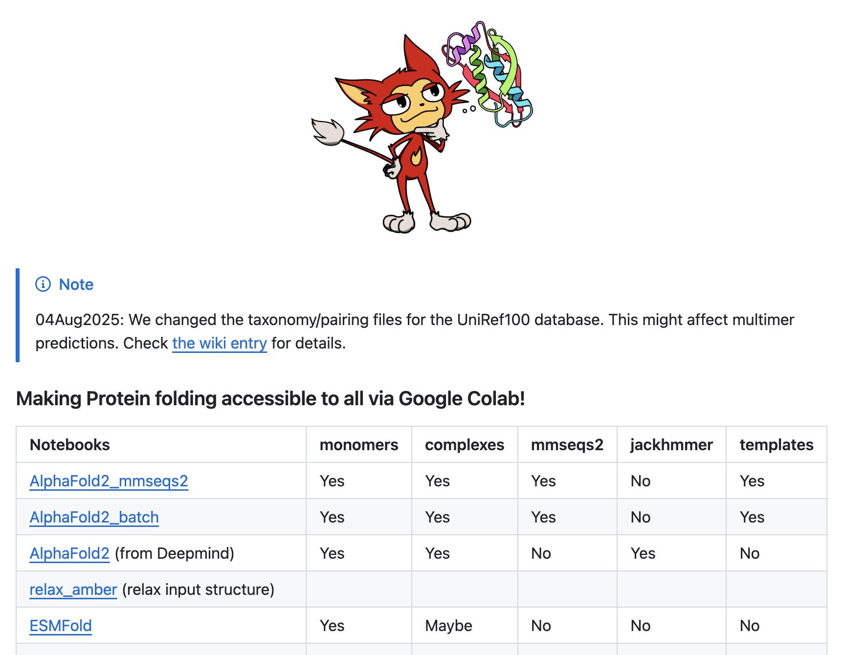
ColabFold – do it online
Sześcian
Sześcian
Sześcian
Sześcian

Slide 54
RFDiffusion – inverse problem
Sześcian
🌫️ Diffusion model for *de novo* protein backbone generation
Sześcian
🧱 Conditions on motifs or geometric constraints
Sześcian
Sześcian
🧬 Generates novel, stable, functional folds

Slide 55
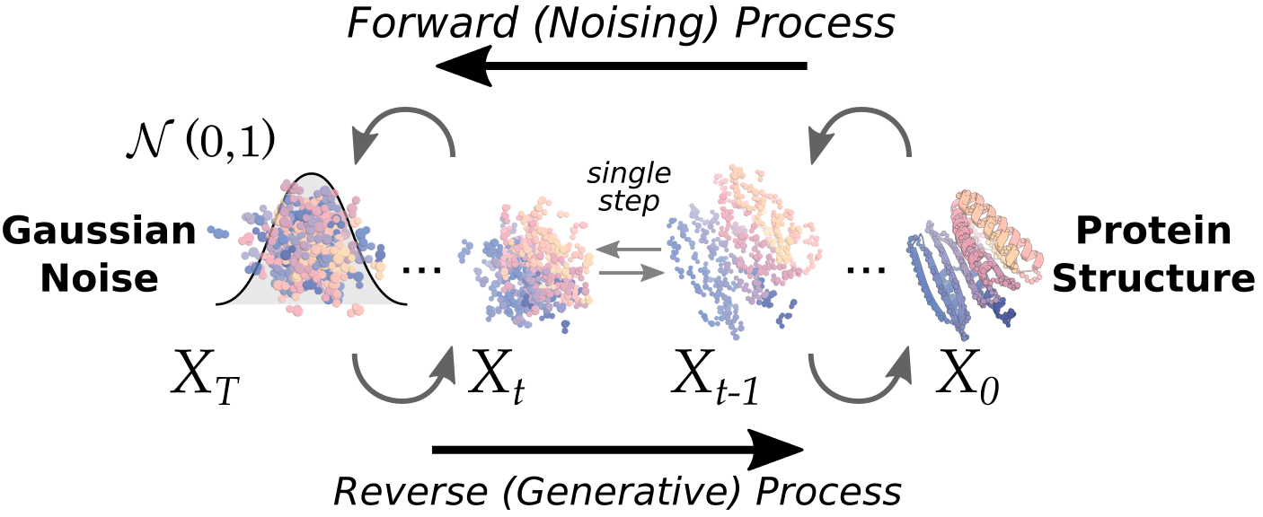
RFDiffusion – inverse problem
Sześcian
Sześcian
Sześcian
Sześcian

Slide 56
Protein MPNN
Sześcian
🧠 Graph neural network for sequence design on a fixed backbone
Sześcian
🎯 Predicts residue identity at each position
Sześcian
Sześcian
🧩 Used after backbone generation (e.g., RFDiffusion)

Slide 57
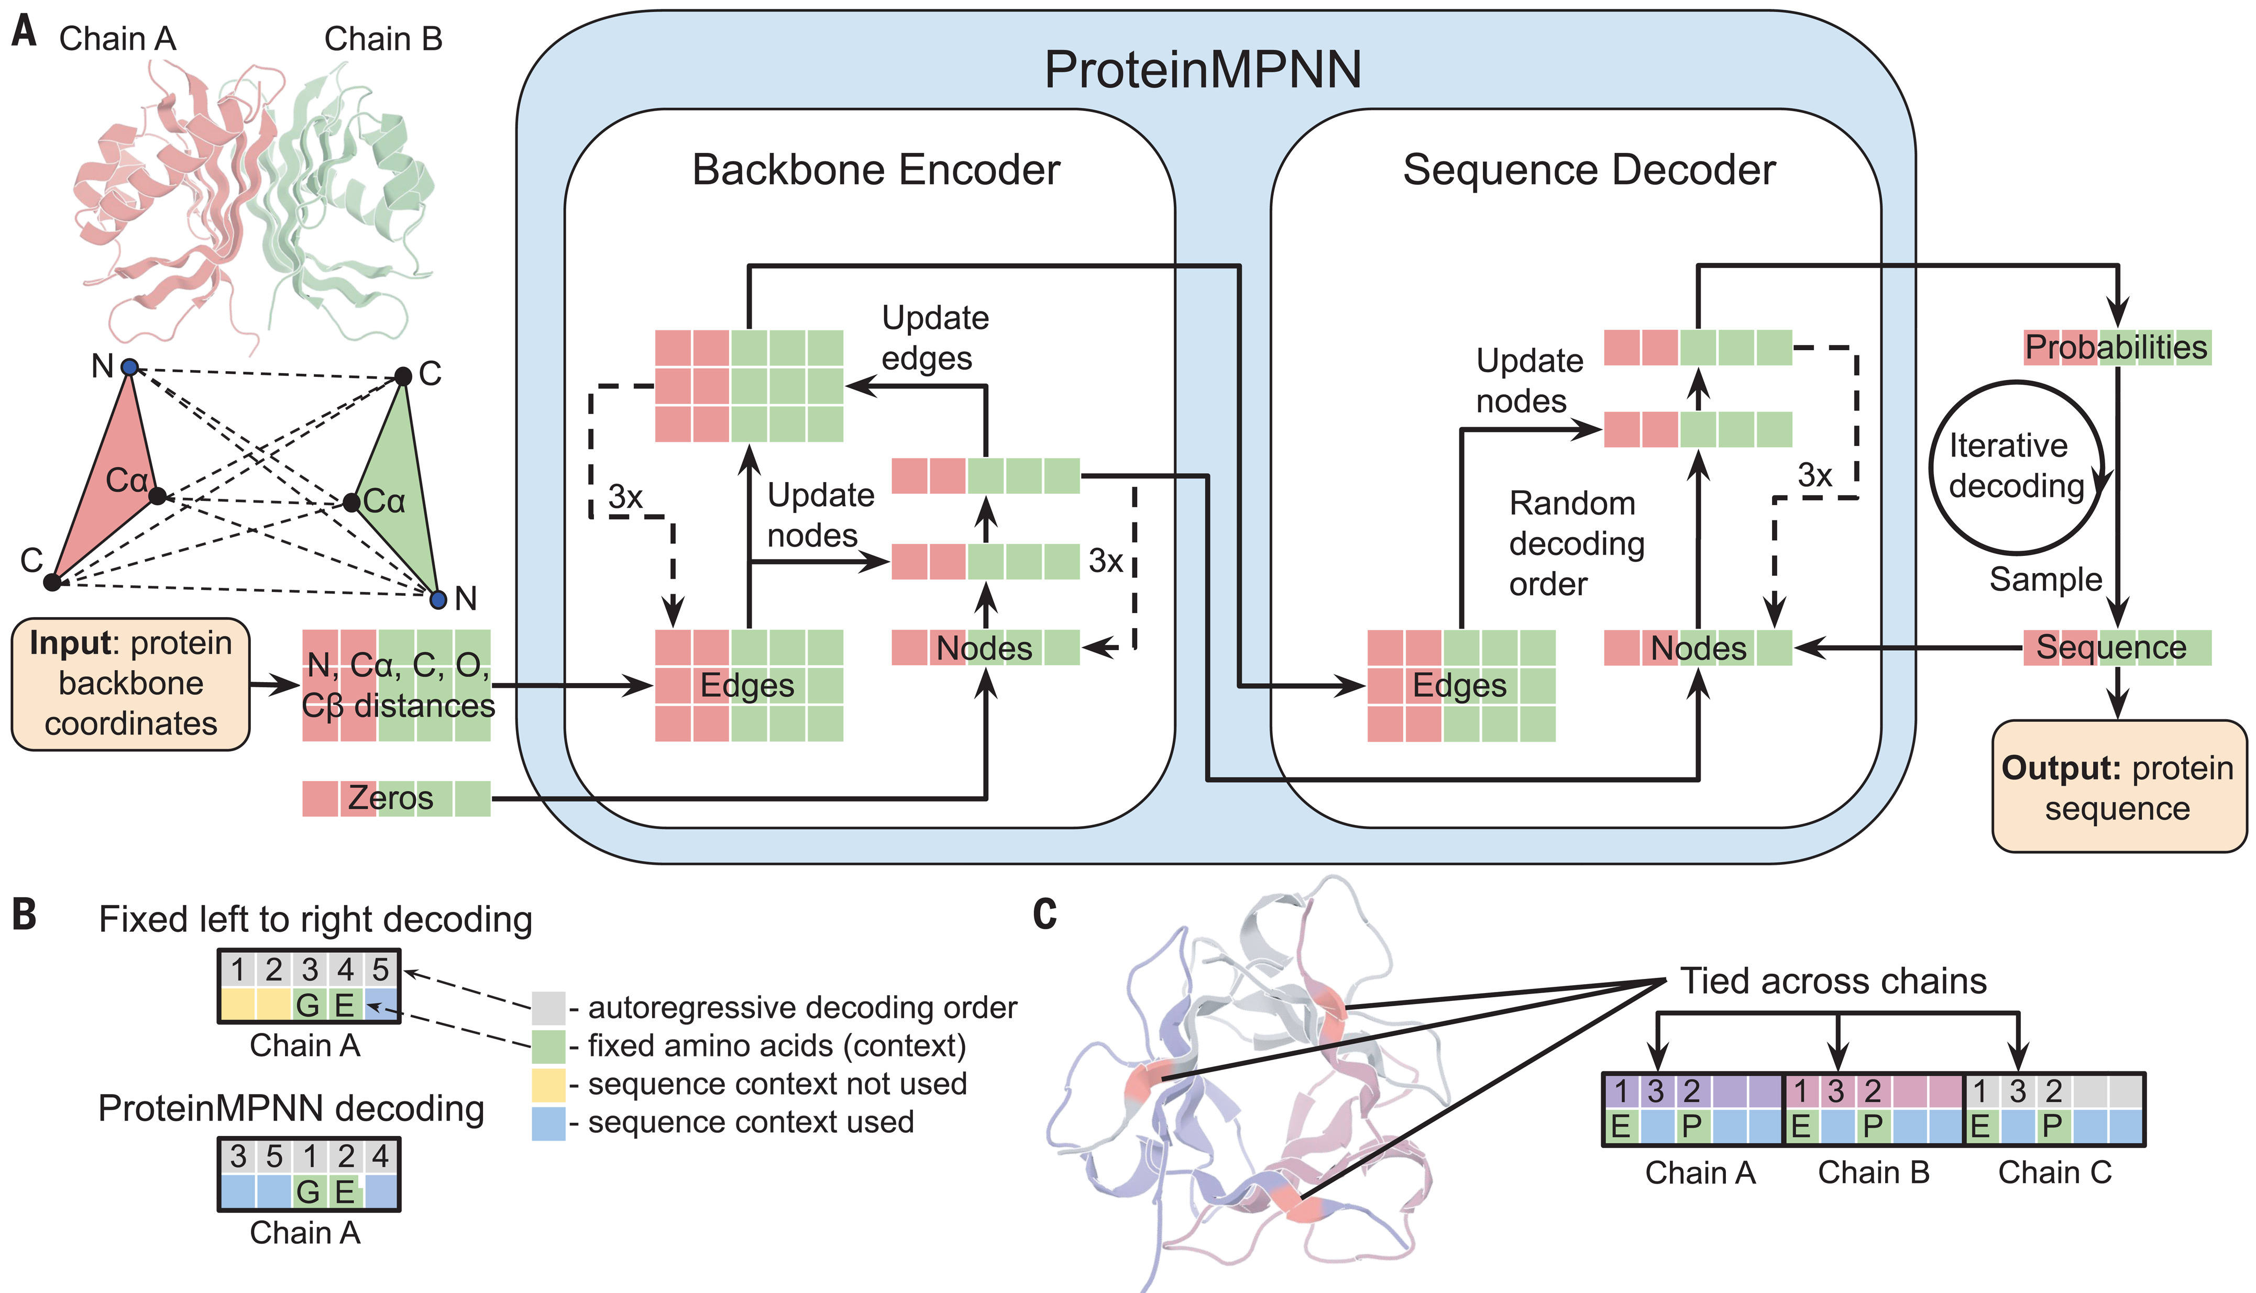
Protein MPNN
Sześcian
Sześcian
Sześcian
Sześcian

Slide 58
Other similar tools
Sześcian
🌈 Chroma - Diffusion model for joint sequence–structure generation
Sześcian
💬 Progen - Transformer language model for protein sequence generation
Sześcian
Sześcian
🍏 SimpleFold – simplistic FlowMatching model from Apple

Slide 59
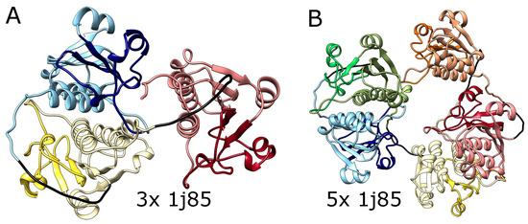
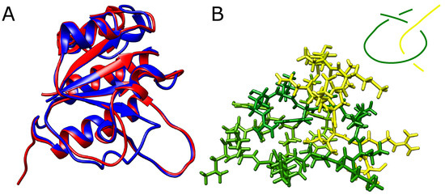
Is the problem solved?
Sześcian
Sześcian
Sześcian
Dabrowski-Tumanski, P., & Stasiak, A. (2023). Alphafold blindness to topological barriers affects its ability to correctly predict proteins’ topology. Molecules, 28(22), 7462.
Sześcian

Slide 60
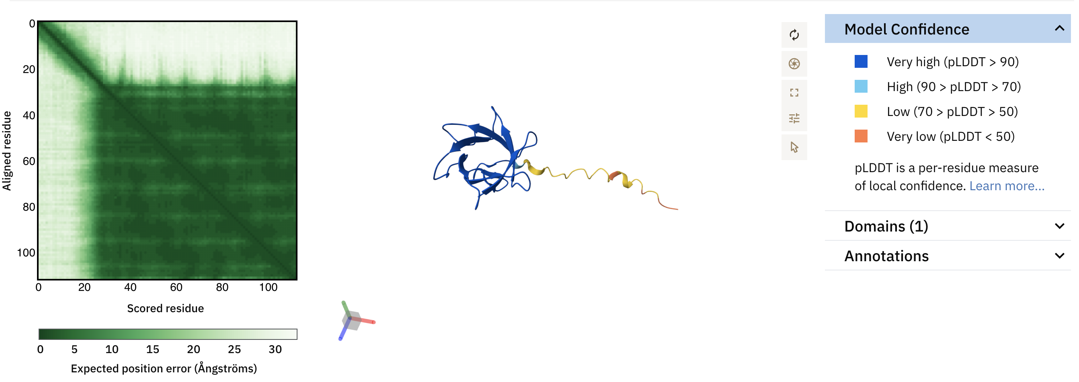

AlphaFold DB
Sześcian
Sześcian
Sześcian
Sześcian
🧮 200M new protein structures!

Slide 61
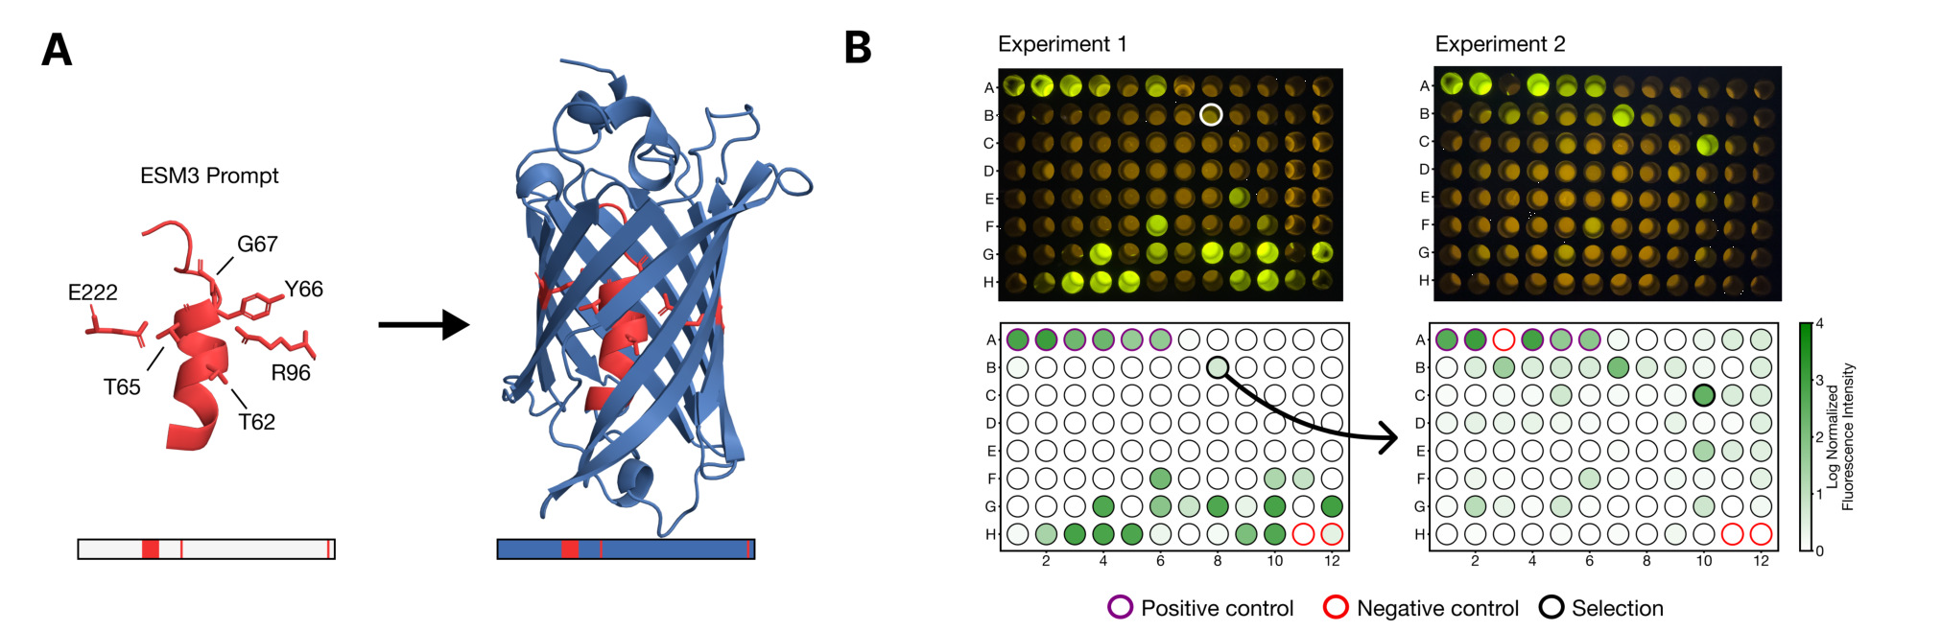
Design of proteins with specific function
Sześcian
Sześcian
Sześcian
Sześcian
Hayes, T., Rao, R., Akin, H., Sofroniew, N. J., Oktay, D., Lin, Z., ... & Rives, A. (2025). Simulating 500 million years of evolution with a language model. Science, 387(6736), 850-858.

Slide 62
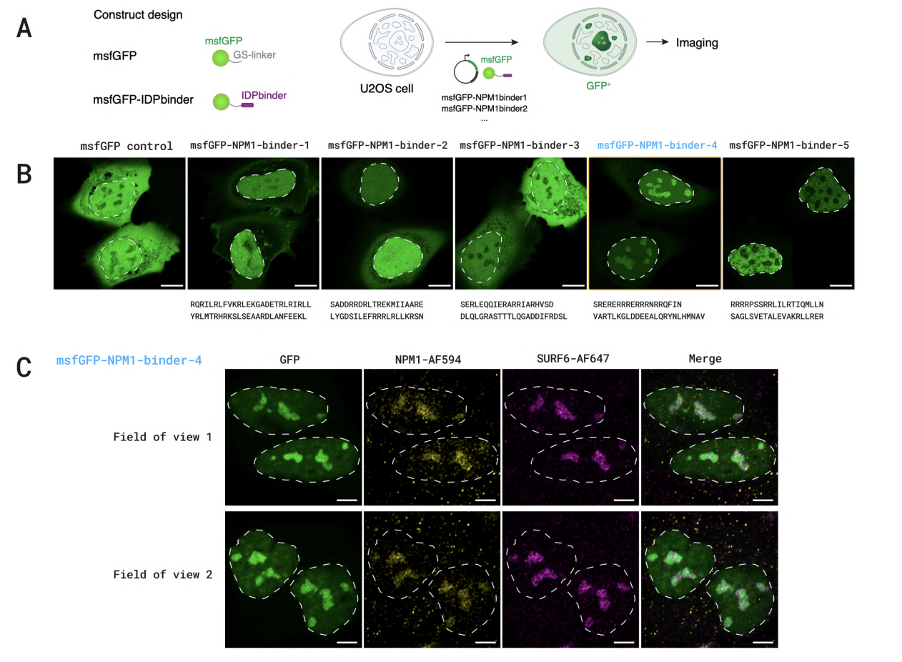
Antibody design
Sześcian
Sześcian
Sześcian
Sześcian
BoltzGen: Toward Universal Binder Design

Slide 63
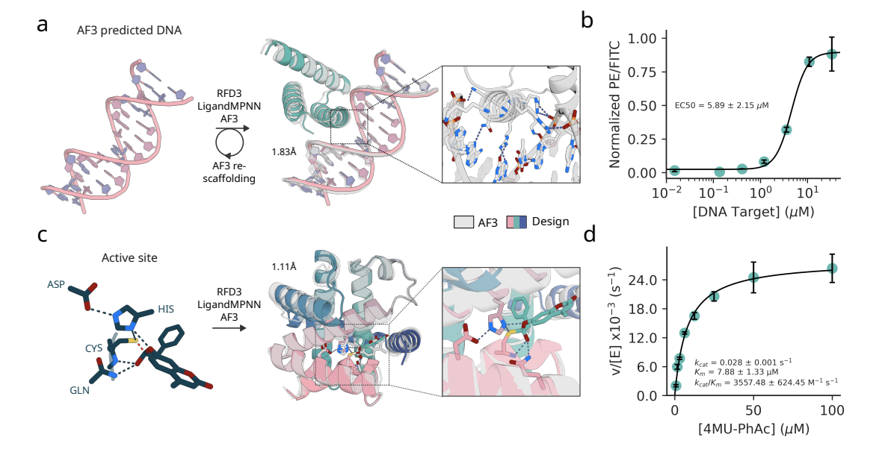
Enzyme design
Sześcian
Sześcian
Sześcian
Sześcian
Butcher, J. K. V., Krishna, R., Mitra, R., Brent, R. I., Li, Y., Corley, N., ... & Baker, D. (2025). De novo Design of All-atom Biomolecular Interactions with RFdiffusion3. bioRxiv.

Slide 64
Other
Sześcian
🔷 Protein function annotation
Sześcian
🔷 Variant effect prediction
Sześcian
Sześcian
🔷 Protein-protein interactions

Slide 65





Wrap-Up
🔷 Instead of sequence homology one might use structural similarity
🔷 MSA is a key tool in protein and gene analysis
🔷 Deep learning models solved many previously unsolved problems
🔷 We are currently facing completely new opening in biology

